Slide 1
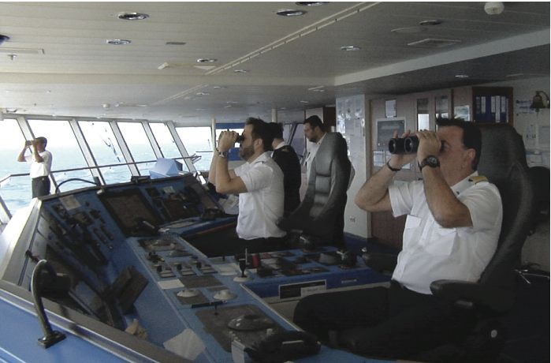
Operations Strategy in a Global Environment
2
PowerPoint presentation to accompany
Heizer, Render, Munson
Operations Management, Thirteenth Edition, Global Edition
Principles of Operations Management, Eleventh Edition
PowerPoint slides by Jeff Heyl

Slide 2
Outline
Global Company Profile: Boeing
A Global View of Operations and Supply Chains
Developing Missions and Strategies
Achieving Competitive Advantage Through Operations
Issues in Operations Strategy

Slide 3
Outline – Continued
Strategy Development and Implementation
Strategic Planning, Core Competencies, and Outsourcing
Global Operations Strategy Options

Slide 4
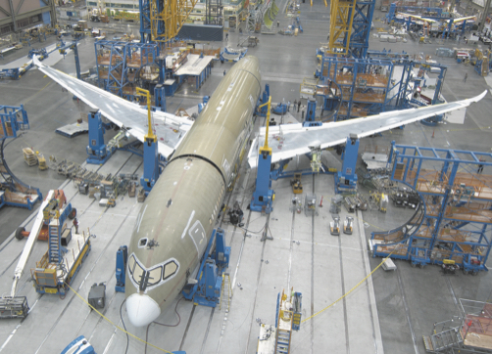
Boeing’s Global Supply-Chain Strategy
 | Some of the International Suppliers of Boeing 787 Components
SUPPLIER |  | HEADQUARTERS COUNTRY | COMPONENT
Latecoere |  | France | Passenger doors
Labinel |  | France | Wiring
Dassault |  | France | Design and PLM software
Messier-Bugatti |  | France | Electric brakes
Thales |  | France | Electrical power conversion system
Messier-Dowty |  | France | Landing gear structure
Diehl |  | Germany | Interior lighting

Slide 5
Boeing’s Global Supply-Chain Strategy
 | Some of the International Suppliers of Boeing 787 Components
SUPPLIER |  | HEADQUARTERS COUNTRY | COMPONENT
Cobham |  | UK | Fuel pumps and valves
Rolls-Royce |  | UK | Engines
Smiths Aerospace |  | UK | Central computer system
BAE Systems |  | UK | Electronics
Alenia Aeronautica |  | Italy | Upper center fuselage
Toray Industries |  | Japan | Carbon fiber for wing and tail units
Fuji Heavy Industries |  | Japan | Center wing box

Slide 6
Boeing’s Global Supply-Chain Strategy
 | Some of the International Suppliers of Boeing 787 Components
SUPPLIER |  | HEADQUARTERS COUNTRY | COMPONENT
Kawasaki Heavy Industries |  | Japan | Forward fuselage, fixed sections of wing
Teijin Seiki |  | Japan | Hydraulic actuators
Mitsubishi Heavy Industries |  | Japan | Wing box
Chengdu Aircraft |  | China | Rudder
Hafei Aviation |  | China | Parts
Korean Airlines |  | South Korea | Wingtips
Saab |  | Sweden | Cargo and access doors

Slide 7
Learning Objectives
When you complete this chapter you should be able to:
2.1 Define mission and strategy
2.2 Identify and explain three strategic approaches to competitive advantage
2.3 Understand the significant key success factors and core competencies

Slide 8
Learning Objectives
When you complete this chapter you should be able to:
2.4 Use factor rating to evaluate both country and provider outsources
2.5 Identify and explain four global operations strategy options

Slide 9
Global Strategies
Boeing – sales and supply chain are worldwide
Benetton – moves inventory to stores around the world faster than its competition by building flexibility into design, production, and distribution
Sony – purchases components from suppliers in Thailand, Malaysia, and around the world

Slide 10
Global Strategies
Volvo – considered a Swedish company, purchased by a Chinese company, Geely. The current Volvo S40 is assembled in Belgium and Malaysia on a platform shared with the Mazda 3 (built in Japan) and the Ford Focus (built in six countries including the U.S.).
Haier – A Chinese company, produces compact refrigerators (it has one-third of the U.S. market) and wine cabinets (it has half of the U.S. market) in South Carolina and other appliances in Kentucky.

Slide 11
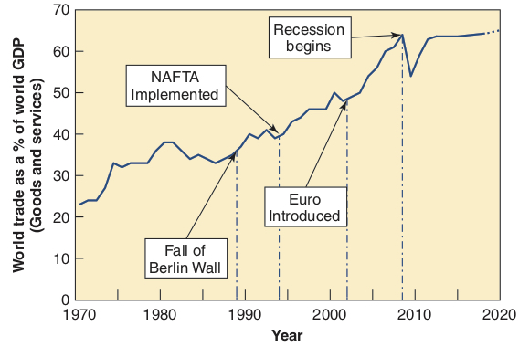
Growth of World Trade
Figure 2.1

Slide 12
Reasons to Globalize
Improve the supply chain
Reduce costs and exchange rate risks
Improve operations
Understand markets
Improve products
Attract and retain global talent

Slide 13
Improve the Supply Chain
Locating facilities closer to unique resources
Auto design to California
Perfume manufacturing in France

Slide 14
Reduce Costs
Risks associated with currency exchange rates
Reduce direct and indirect costs
Trade agreements can lower tariffs
Maquiladoras
World Trade Organization (WTO)
North American Free Trade Agreement (NAFTA)
APEC, SEATO, MERCOSUR, CAFTA
European Union (EU)

Slide 15
Improve Operations
Understand differences between how business is handled in other countries
Japanese – inventory management
Germans – robots
Scandinavians – ergonomics
International operations can improve response time and customer service

Slide 16
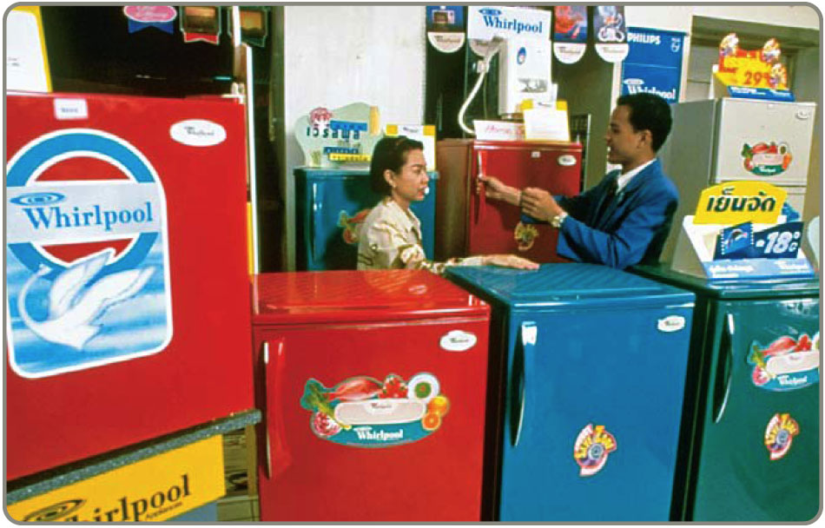
Understand Markets
Interacting with foreign customers, suppliers, competition can lead to new opportunities
Cell phone design moved from Europe to Japan and India
Extend the product life cycle

Slide 17
Improve Products
Remain open to free flow of ideas
Toyota and BMW manage joint research and development
Reduced risk, state-of-the-art design, lower costs
Samsung and Bosch jointly produce batteries

Slide 18
Attract and Retain Global Talent
Offer better employment opportunities
Better growth opportunities and insulation against unemployment
Relocate unneeded personnel to more prosperous locations

Slide 19
Cultural and Ethical Issues
Social and cultural behavior differs
International laws, agreements, codes of conduct for ethical behaviors
Despite cultural and ethical differences, we observe extraordinary mobility of capital, information, goods, and people

Slide 20
Companies Want To Consider
National literacy rate
Rate of innovation
Rate of technology change
Number of skilled workers
Political stability
Product liability laws
Export restrictions
Variations in language
Work ethic
Tax rates
Inflation
Availability of raw materials
Interest rates
Population
Transportation infrastructure
Communication system

Slide 21
Match Product and Parent
Braun Household Appliances
Firestone Tires
Godiva Chocolate
Haagen-Dazs Ice Cream
Jaguar Autos
GE Appliances
Lamborghini Autos
Alpo Petfoods
Volkswagen
Bridgestone
Campbell Soup
Tata Motors Limited
Proctor & Gamble
Nestlé
Pillsbury
Haier

Slide 22
Match Product and Country
Braun Household Appliances
Firestone Tires
Godiva Chocolate
Haagen-Dazs Ice Cream
Jaguar Autos
GE Appliances
Lamborghini Autos
Alpo Petfoods
Great Britain
Germany
China
United States
Switzerland
India

Slide 23
Developing Missions and Strategies
Mission statements tell an organization where it is going
The Strategy tells the organization how to get there

Slide 24
Mission
Mission - where is the organization going?
Organization’s purpose for being
Answers “What do we contribute to society?”
Provides boundaries and focus

Slide 25
Merck
The mission of Merck is to provide society with superior products and services—innovations and solutions that improve the quality of life and satisfy customer needs—to provide employees with meaningful work and advancement opportunities and investors with a superior rate of return.
Figure 2.2

Slide 26
PespsiCo
Our mission is to be the world's premier consumer products company focused on convenient foods and beverages. We seek to produce financial rewards to investors as we provide opportunities for growth and enrichment to our employees, our business partners and the communities in which we operate. And in everything we do, we strive for honesty, fairness and integrity.
Figure 2.2

Slide 27
Arnold Palmer Hospital
Arnold Palmer Hospital for Children provides state of the art, family-centered healthcare focused on restoring the joy of childhood in an environment of compassion, healing, and hope.
Figure 2.2

Slide 28
Factors Affecting Mission
Philosophy and Values
Profitability and Growth
Environment
Mission
Customers
Public Image
Benefit to Society

Slide 29
Strategic Process
Organization’s Mission
Functional Area Missions
Finance/ Accounting
Marketing
Operations

Slide 30
Sample Missions
Sample Company Mission
To manufacture and service an innovative, growing, and profitable worldwide microwave communications business that exceeds our customers’ expectations.
Sample Operations Management Mission
To produce products consistent with the company’s mission as the worldwide low-cost manufacturer.
Figure 2.3

Slide 31
Sample Missions
Sample OM Department Missions
Product design | To design and produce products and services with outstanding quality and inherent customer value.
Quality management | To attain the exceptional value that is consistent with our company mission and marketing objectives by close attention to design, supply chain, production, and field service opportunities
Process design | To determine, design, and develop the production process and equipment that will be compatible with low-cost product, high quality, and good quality of work life.
Figure 2.3

Slide 32
Sample Missions
Sample OM Department Missions
Location | To locate, design, and build efficient and economical facilities that will yield high value to the company, its employees, and the community.
Layout design | To achieve, through skill, imagination, and resourcefulness in layout and work methods, production effectiveness and efficiency while supporting a high quality of work life.
Human resources | To provide a good quality of work life, with well-designed, safe, rewarding jobs, stable employment, and equitable pay, in exchange for outstanding individual contribution from employees at all levels.
Figure 2.3

Slide 33
Sample Missions
Sample OM Department Missions
Supply-chain management | To collaborate with suppliers to develop innovative products from stable, effective, and efficient sources of supply.
Inventory | To achieve low investment in inventory consistent with high customer service levels and high facility utilization.
Scheduling | To achieve high levels of throughput and timely customer delivery through effective scheduling.
Maintenance | To achieve high utilization of facilities and equipment by effective preventive maintenance and prompt repair of facilities and equipment.
Figure 2.3

Slide 34
Strategy
Strategies require managers to
Develop action plan to achieve mission
Ensure functional areas have supporting strategies
Exploit opportunities and strengths, neutralize threats, and avoid weaknesses

Slide 35
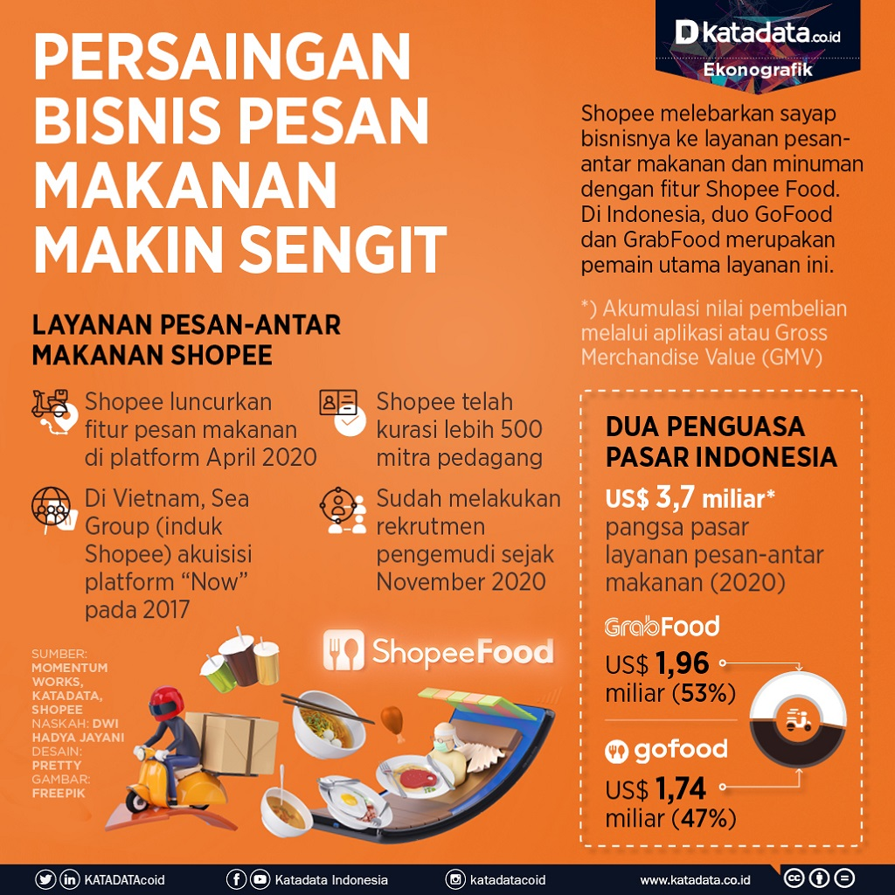

Slide 36
Strategies for Competitive Advantage
Differentiation – better, or at least different
Cost leadership – cheaper
Response – more responsive

Slide 37
Competing on Differentiation
Uniqueness can go beyond both the physical characteristics and service attributes to encompass everything that impacts customer's perception of value
Safeskin gloves – leading edge products
Walt Disney Magic Kingdom – experience differentiation
Hard Rock Cafe – dining experience

Slide 38
Experience Differentiation
Engaging a customer with a product through imaginative use of the five senses, so the customer “experiences” the product
Theme parks use sight, sound, smell, and participation
Movie theatres use sight, sound, moving seats, smells, and mists of rain
Restaurants use music, smell, and open kitchens

Slide 39
Competing on Cost
Provide the maximum value as perceived by customer. Does not imply low quality.
Southwest Airlines – secondary airports, no frills service, efficient utilization of equipment
Walmart – small overhead, shrinkage, and distribution costs
Franz Colruyt – no bags, no bright lights, no music

Slide 40
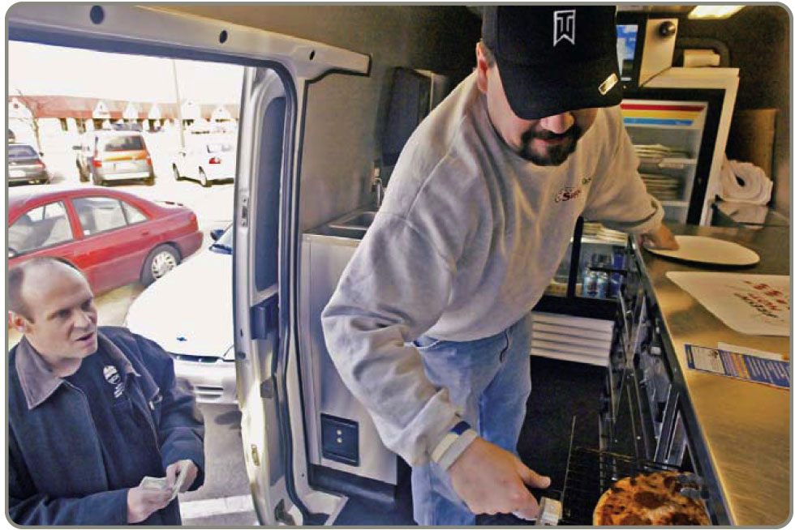
Competing on Response
Flexibility is matching market changes in design innovation and volumes
A way of life at Hewlett-Packard
Reliability is meeting schedules
German machine industry
Quickness in design, production, and delivery
Johnson Electric, Pizza Hut

Slide 41
OM’s Contribution to Strategy
10 Operations Competitive
Decisions Strategy Example Advantage
Product
Quality
Process
Location
Layout
Human resource
Supply chain
Inventory
Scheduling
Maintenance
DIFFERENTIATION:
Innovative design ………... Safeskin’s innovative gloves
Broad product line ……… Fidelity Security’s mutual funds
After-sales service …….. Caterpillar’s heavy equipment service
Experience …………….. Hard Rock Café’s dining experience
COST LEADERSHIP:
Low overhead ……… Franz-Colruyt’s warehouse-type stores
Effective capacity … Southwest Airline’s
use aircraft utilization
Inventory ……………. Walmart’s sophisticated
management distribution system
RESPONSE:
Flexibility …………….. Hewlett-Packard’s response to volatile world market
Reliability ……………… FedEx’s “absolutely, positively, on time”
Quickness ………………. Pizza Hut’s 5-minute guarantee at lunchtime
Differentiation
(better)
Response
(faster)
Cost leadership
(cheaper)
Figure 2.4

Slide 42
Issues In Operations Strategy
Resources view
Value-chain analysis
Porter’s Five Forces model
Operating in a system with many external factors
Constant change

Slide 43
Product Life Cycle
Introduction Growth Maturity Decline
Best period to increase market share
R&D engineering is critical
Practical to change price or quality image
Strengthen niche
Poor time to change image, price, or quality
Competitive costs become critical
Defend market position
Cost control critical
Company Strategy/Issues
Hybrid engine vehicles
Xbox One
Boeing 787
3D printers
Boeing 747
Life Cycle Curve
Electric vehicles
DVDs
Autonomous vehicles
Virtual reality
Video physical rentals
Figure 2.5

Slide 44
Product Life Cycle
Introduction Growth Maturity Decline
Introduction Growth Maturity Decline
Product design and development critical
Frequent product and process design changes
Short production runs
High production costs
Limited models
Attention to quality
Forecasting critical
Product and process reliability
Competitive product improvements and options
Increase capacity
Shift toward product focus
Enhance distribution
Standardization
Fewer rapid product changes, more minor changes
Optimum capacity
Increasing stability of process
Long production runs
Product improvement and cost cutting
Little product differentiation
Cost minimization
Overcapacity in the industry
Prune line to eliminate items not returning good margin
Reduce capacity
OM Strategy/Issues
OM Strategy/Issues
Figure 2.5

Slide 45
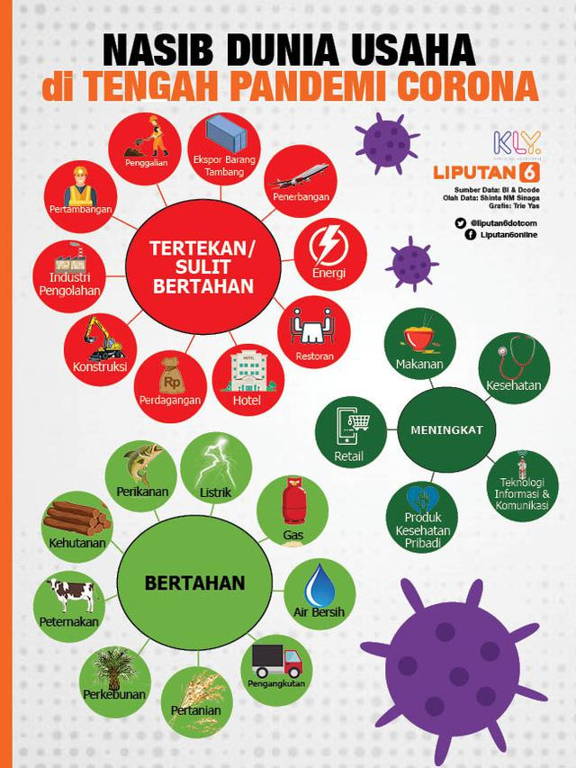

Slide 46
SWOT Analysis
Mission
Internal Strengths
External Opportunities
Analysis
Internal Weaknesses
External Threats
Strategy

Slide 47
Strategy Development Process
Analyze the Environment
Identify the strengths, weaknesses, opportunities, and threats. Understand the environment, customers, industry, and competitors.
Determine the Corporate Mission
State the reason for the firm’s existence and identify the value it wishes to create.
Form a Strategy
Build a competitive advantage, such as low price, design, or volume flexibility, quality, quick delivery, dependability, after-sale service, broad product lines.
Figure 2.6

Slide 48
Strategy Development and Implementation
Identify key success factors
Integrate OM with other activities
Build and staff the organization
The operations manager’s job is to implement an OM strategy, provide competitive advantage, and increase productivity

Slide 49
Key Success Factors
Support a Core Competence and Implement Strategy by
Identifying and Executing the Key Success Factors in the Functional Areas
Marketing
Service Distribution Promotion Channels of distribution Product positioning (image, functions)
Finance/Accounting
Leverage Cost of capital Working capital Receivables Payables Financial control Lines of credit
Production/Operations
10 OM Decisions | Sample Options | Chapter
Product Quality Process Location Layout Human resource Supply chain Inventory Schedule Maintenance | Customized, or standardized; sustainability Define customer quality expectations and how to achieve them Facility size, capacity, how much automation Near supplier or near customer Work cells or assembly line Specialized or enriched jobs Single or multiple suppliers When to reorder, how much to keep on hand Stable or fluctuating production rate Repair as required or preventive maintenance | 5, S5 6, S6 7, S7 8 9 10 11, S11 12, 14, 16 13, 15 17
Figure 2.7

Slide 50
Activity Mapping at Southwest Airlines
Courteous, but Limited Passenger Service
Lean, Productive Employees
Short Haul, Point-to-Point Routes, Often to Secondary Airports
Competitive Advantage:
Low Cost
High Aircraft Utilization
Frequent, Reliable Schedules
Standardized Fleet of Boeing 737 Aircraft
Figure 2.8

Slide 51
Activity Mapping at Southwest Airlines
Courteous, but Limited Passenger Service
Lean, Productive Employees
Point-to-Point Routes, Often to Secondary Airports
Automated ticketing
No seat assignments
“Bags fly free” and no baggage transfers
No meals
Competitive Advantage:
Low Cost
High Aircraft Utilization
Frequent, Reliable Schedules
Standardized Fleet of Boeing 737 Aircraft
Figure 2.8

Slide 52
Activity Mapping at Southwest Airlines
Courteous, but Limited Passenger Service
No meals
Lower gate costs at secondary airports
High number of flights reduces employee idle time between flights
Lean, Productive Employees
Point-to-Point Routes, Often to Secondary Airports
Competitive Advantage:
Low Cost
High Aircraft Utilization
Frequent, Reliable Schedules
Standardized Fleet of Boeing 737 Aircraft
Figure 2.8

Slide 53
Activity Mapping at Southwest Airlines
Courteous, but Limited Passenger Service
Lean, Productive Employees
Point-to-Point Routes, Often to Secondary Airports
High number of flights reduces employee idle time between flights
Saturate a city with flights, lowering administrative costs per passenger for that city
Pilot training required on only one type of aircraft
Reduced maintenance inventory required because of only one type of aircraft
Competitive Advantage:
Low Cost
High Aircraft Utilization
Frequent, Reliable Schedules
Standardized Fleet of Boeing 737 Aircraft
Figure 2.8

Slide 54
Activity Mapping at Southwest Airlines
Courteous, but Limited Passenger Service
Pilot training required on only one type of aircraft
Reduced maintenance inventory required because of only one type of aircraft
Excellent supplier relations with Boeing have aided financing
Lean, Productive Employees
Point-to-Point Routes, Often to Secondary Airports
Competitive Advantage:
Low Cost
High Aircraft Utilization
Frequent, Reliable Schedules
Standardized Fleet of Boeing 737 Aircraft
Figure 2.8

Slide 55
Activity Mapping at Southwest Airlines
Courteous, but Limited Passenger Service
Lean, Productive Employees
Point-to-Point Routes, Often to Secondary Airports
Reduced maintenance inventory required because of only one type of aircraft is used
Flexible employees/unions and standard planes aid scheduling
Maintenance personnel trained on only one type of aircraft
20-minute gate turnarounds
Competitive Advantage:
Low Cost
High Aircraft Utilization
Frequent, Reliable Schedules
Standardized Fleet of Boeing 737 Aircraft
Figure 2.8

Slide 56
Activity Mapping at Southwest Airlines
Courteous, but Limited Passenger Service
Automated ticketing
Empowered employees
High employee compensation
Hire for attitude, then train
High level of stock ownership
High number of flights reduces employee idle time between flights
Lean, Productive Employees
Point-to-Point Routes, Often to Secondary Airports
Competitive Advantage:
Low Cost
High Aircraft Utilization
Frequent, Reliable Schedules
Standardized Fleet of Boeing 737 Aircraft
Figure 2.8

Slide 57
Implementing Strategic Decisions
TABLE 2.1 | Operations Strategies of Two Drug Companies
COMPETITIVE ADVANTAGE | BRAND NAME DRUGS, INC. | GENERIC DRUGS CORP.
 | PRODUCT DIFFERENTIATION STRATEGY | LOW-COST STRATEGY
Product selection and design | Heavy R&D investment; extensive labs; focus on development in a broad range of drug categories | Low R&D investment; focus on development of generic drugs
Quality | Quality is major priority, standards exceed regulatory requirements | Meets regulatory requirements on a country-by-country basis, as necessary
Process | Product and modular production process; tries to have long product runs in specialized facilities; builds capacity ahead of demand | Process focused; general production processes; “job shop” approach, short-run production; focus on high utilization
Location | Still located in city where it was founded | Recently moved to low-tax, low-labor-cost environment

Slide 58
Implementing Strategic Decisions
TABLE 2.1 | Operations Strategies of Two Drug Companies
COMPETITIVE ADVANTAGE | BRAND NAME DRUGS, INC. | GENERIC DRUGS CORP.
 | PRODUCT DIFFERENTIATION STRATEGY | LOW-COST STRATEGY
Layout | Layout supports automated product-focused production | Layout supports process-focused “job shop” practices
Human resources | Hire the best; nationwide searches | Very experienced top executives provide direction; other personnel paid below industry average
Supply chain | Long-term supplier relationships | Tends to purchase competitively to find bargains
Inventory | Maintains high finished goods inventory primarily to ensure all demands are met | Process focus drives up work-in-process inventory; finished goods inventory tends to be low
Scheduling | Centralized production planning | Many short-run products complicate scheduling
Maintenance | Highly trained staff; extensive parts inventory | Highly trained staff to meet changing process and equipment demands

Slide 59
Strategic Planning, Core Competencies, and Outsourcing
Outsourcing – transferring activities that have traditionally been internal to external suppliers
Accelerating due to
Increased technological expertise
More reliable and cheaper transportation
Rapid development and deployment of advancements in telecommunications and computers

Slide 60
Strategic Planning, Core Competencies, and Outsourcing
Subcontracting - contract manufacturing
Outsourced activities
Legal services
IT services
Travel services
Payroll
Production
Surgery

Slide 61
Theory of Comparative Advantage
If an external provider can perform activities more productively than the purchasing firm, then the external provider should do the work
Purchasing firm focuses on core competencies
Drives outsourcing

Slide 62
Risks of Outsourcing
TABLE 2.2 | Potential Advantages and Disadvantages of Outsourcing
ADVANTAGES |  | DISADVANTAGES
Cost savings |  | Increased logistics and inventory costs
Gaining outside expertise that comes with specialization |  | Loss of control (quality, delivery, etc.)
Improving operations and service |  | Potential creation of future competition
Maintaining a focus on core competencies |  | Negative impact on employees
Accessing outside technology |  | Risks may not manifest themselves for years

Slide 63
Rating Outsourcing Providers
Insufficient analysis most common reason for failure
Factor-rating method
Points are assigned for each factor for each provider
Weights are assigned to each factor

Slide 64
Rating Provider Selection Criteria
TABLE 2.3 | Factor Ratings Applied to National Architects' Potential IT Outsourcing Providers
 |  | IMPORTANCE WEIGHTS |  |  | OUTSOURCING PROVIDERS
FACTOR (CRITERION) |  |  |  |  | BIM (U.S.) |  |  | S.P.C. (INDIA) |  |  | TELCO (ISRAEL)
1. Can reduce operating costs |  |  | .2 |  |  | 3 |  |  | 3 |  |  | 5
2. Can reduce capital investment |  |  | .2 |  |  | 4 |  |  | 3 |  |  | 3
3. Skilled personnel |  |  | .2 |  |  | 5 |  |  | 4 |  |  | 3
4. Can improve quality |  |  | .1 |  |  | 4 |  |  | 5 |  |  | 2
5. Can gain access to technology not in company |  |  | .1 |  |  | 5 |  |  | 3 |  |  | 5
6. Can create additional capacity |  |  | .1 |  |  | 4 |  |  | 2 |  |  | 4
7. Aligns with policy/philosophy/culture |  |  | .1 |  |  | 2 |  |  | 3 |  |  | 5
Total Weighted Score |  |  | 1.0 |  |  | 3.9 |  |  | 3.3 |  |  | 3.8
Score for BIM = (.2 * 3) + (.2 * 4) + (.2 * 5) + (.1 * 4) + (.1 * 5) + (.1 * 4) + (.1 * 2) = 3.9

Slide 65
Global Operations Strategy Options
High
Figure 2.9
International strategy
Import/export or license existing product
Cost Reduction
Examples:
U.S. Steel
Harley-Davidson
Low
Low
High
Local Responsiveness
(Quick Response and/or Differentiation)

Slide 66
Global Operations Strategy Options
High
Figure 2.9
Cost Reduction
International
strategy
Import/export or license existing product
Examples:
U.S. Steel
Harley-Davidson
Low
Low
High
Local Responsiveness
(Quick Response and/or Differentiation)

Slide 67
Global Operations Strategy Options
High
Global
strategy
Figure 2.9
Standardize product
Economies of scale
Cross-cultural learning
Examples:
Texas Instruments
Caterpillar
Otis Elevator
Cost Reduction
International
strategy
Import/export or license existing product
Examples:
U.S. Steel
Harley-Davidson
Low
Low
High
Local Responsiveness
(Quick Response and/or Differentiation)

Slide 68
Global Operations Strategy Options
High
Global strategy
Figure 2.9
Standardize product
Economies of scale
Cross-cultural learning
Examples:
Texas Instruments
Caterpillar
Otis Elevator
Cost Reduction
International
strategy
Import/export or license existing product
Examples:
U.S. Steel
Harley-Davidson
Low
Low
High
Local Responsiveness
(Quick Response and/or Differentiation)

Slide 69
Global Operations Strategy Options
High
Multidomestic
strategy
Global strategy
Figure 2.9
Standardize product
Economies of scale
Cross-cultural learning
Examples:
Texas Instruments
Caterpillar
Otis Elevator
Use existing domestic model globally
Franchise, joint ventures, subsidiaries
Examples:
Heinz, McDonald’s
The Body Shop
Hard Rock Cafe
Cost Reduction
International
strategy
Import/export or license existing product
Examples:
U.S. Steel
Harley-Davidson
Low
Low
High
Local Responsiveness
(Quick Response and/or Differentiation)

Slide 70
Global Operations Strategy Options
High
Global strategy
Figure 2.9
Standardize product
Economies of scale
Cross-cultural learning
Examples:
Texas Instruments
Caterpillar
Otis Elevator
Cost Reduction
International
strategy
Multidomestic
strategy
Use existing domestic model globally
Franchise, joint ventures, subsidiaries
Examples:
Heinz, McDonald’s
The Body Shop
Hard Rock Cafe
Import/export or license existing product
Examples:
U.S. Steel
Harley-Davidson
Low
Low
High
Local Responsiveness
(Quick Response and/or Differentiation)

Slide 71
Global Operations Strategy Options
High
Global strategy
Transnational
strategy
Figure 2.9
Standardize product
Economies of scale
Cross-cultural learning
Examples:
Texas Instruments
Caterpillar
Otis Elevator
Move material, people, or ideas across national boundaries
Economies of scale
Cross-cultural learning
Examples:
Coca-Cola, Nestlé
Cost Reduction
International
strategy
Multidomestic
strategy
Use existing domestic model globally
Franchise, joint ventures, subsidiaries
Examples:
Heinz, McDonald’s
The Body Shop
Hard Rock Cafe
Import/export or license existing product
Examples:
U.S. Steel
Harley-Davidson
Low
Low
High
Local Responsiveness
(Quick Response and/or Differentiation)

Slide 72
Global Operations Strategy Options
High
Global strategy
Transnational
strategy
Figure 2.9
Standardize product
Economies of scale
Cross-cultural learning
Examples:
Texas Instruments
Caterpillar
Otis Elevator
Move material, people, or ideas across national boundaries
Economies of scale
Cross-cultural learning
Examples:
Coca-Cola, Nestlé
Cost Reduction
International
strategy
Multidomestic
strategy
(eg, Heinz, McDonald’s
The Body Shop
Hard Rock Cafe)
Import/export or license existing product
Examples:
U.S. Steel
Harley-Davidson
Use existing domestic model globally
Franchise, joint ventures, subsidiaries
Low
Low
High
Local Responsiveness
(Quick Response and/or Differentiation)

Slide 73
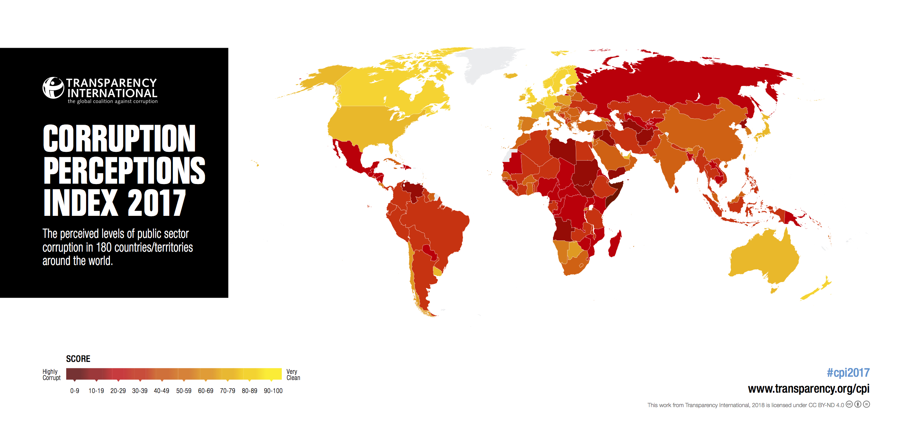

Ranking Corruption
Rank | Country | 2017 CPI Score (out of 100)
1 | New Zealand | 89
2 | Denmark | 88
3 | Finland, Norway, Switzerland | 85
6 | Singapore, Sweden | 84
8 | Canada, UK | 82
12 | Germany | 81
16 | USA | 75
20 | Japan | 73
51 | South Korea | 54
77 | China | 41
135 | Mexico, Russia | 29
180 | Somalia | 9
Least Corrupt
Most Corrupt

Slide 74
